Slide 1
Lecture 10: BIOS and DOS Programming

Slide 2
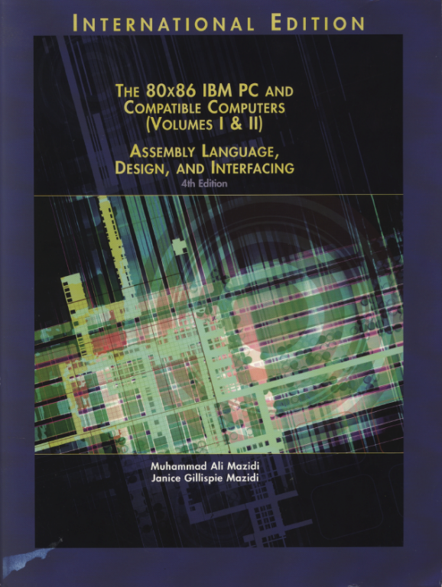
Reference Book:
The 80x86 IBM PC and Compatible Computers
Chapter 4
BOIS and DOS Programming in Assembly and C

Slide 3
BIOS and DOS Interrupts
You can use those useful subroutines within BIOS and DOS to implement your applications
You can “CALL” those subroutines by explicitly embedding BIOS and DOS interrupt instructions in your program
We study: INT 10h (BIOS interrupt) and INT 21h (DOS interrupt)
Each one can perform many functions
See Appendices D and E for the complete function lists

Slide 4
BIOS INT 10H Programming
INT 10H subroutines are burned into the ROM BIOS (in 80x86-based IBM PCs)
Used to communicate with the computer’s screen video
E.g., changing the color of characters or background color, cleaning the screen, changing the location of the cursor, drawing lines on the screen
By setting AH with different values, you can “call” those functions

Slide 5
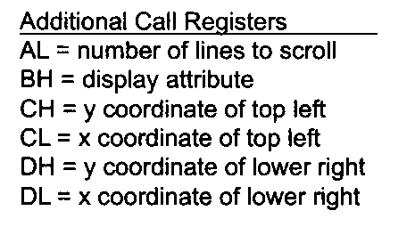
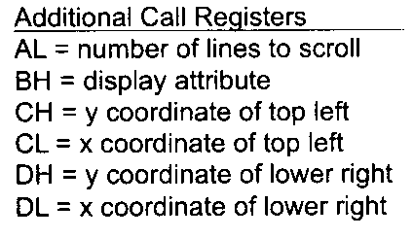
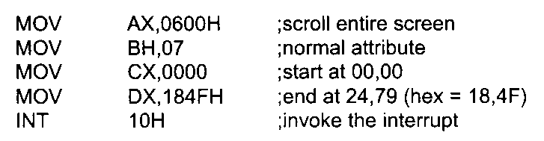
Scrolling Window
Scroll window up
AH=06h
Code example: clear the screen
Scroll window down
AH=07h

Slide 6
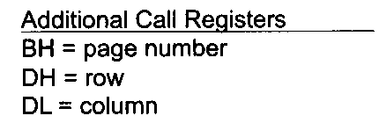
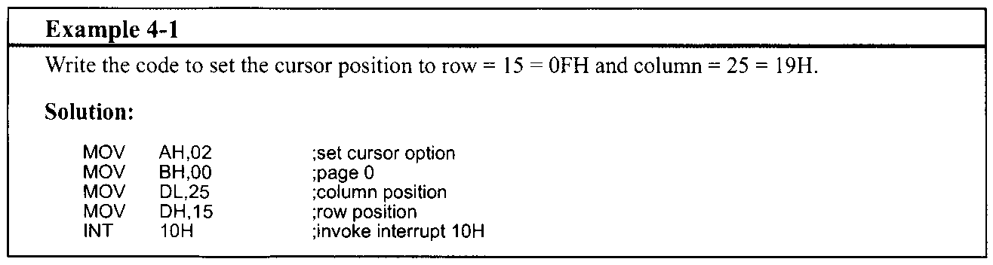
Set cursor position
AH=02h

Slide 7
Set Video Mode
AH=00h
In text mode, the screen is viewed as a matrix of rows and columns of characters
E.g., AL = 03h: VGA 80x25 chars, 16 colors
In graphics mode, the screen is viewed as a matrix of horizontal and vertical pixels
Each pixel can have different color
The size of video memory decides the number of pixels and colors
E.g., AL = 13H: VGA 320x200 pixels, 256 colors

Slide 8
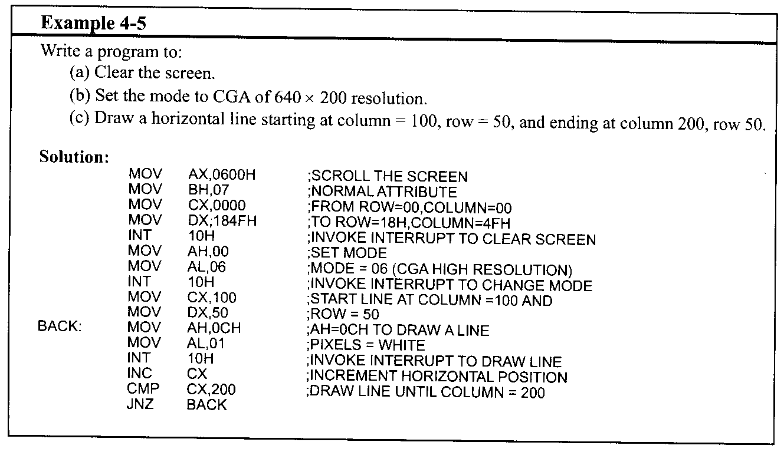
Draw Pixel
AH=0CH
(b) Set the mode to VGA of 320x200 resolution

Slide 9
DOS Interrupt 21H
Provided by MS-DOS
Based on BIOS-ROM
After the DOS is loaded into the memory, you can invoke INT 21H to perform some extremely useful functions
E.g., input from keyboard, display results on screen
By setting AH with different values, you can invoke those functions

Slide 10
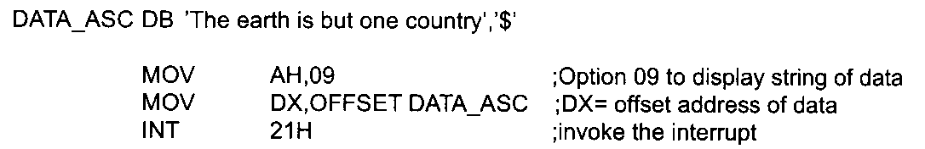
Output String on Screen
AH=09H
Can be used to send a set of ASCII data to the monitor
DX is set to the offset address of the ASCII string to be displayed (DS is assumed to be the data segment)
All characters will be displayed until it encounters the dollar sign “$”

Slide 11
Exit to DOS
AH=4CH
AL=00H
MOV AX, 4C00H
INT 21H

